Slide 1
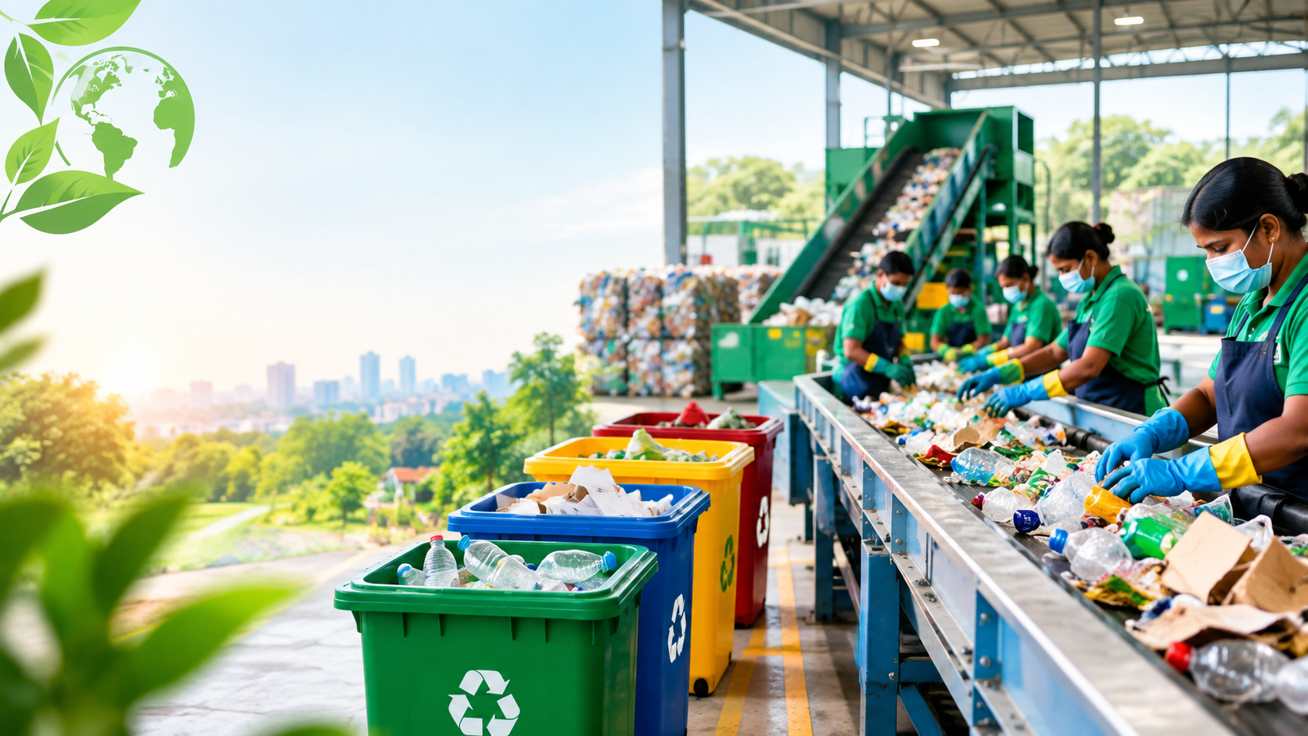
WASTE
MANAGEMENT
SMART • CLEAN • SUSTAINABLE
A simple website that helps people
understand waste segregation,
recycling and responsible disposal.
PROJECT PRESENTATION
♻
Presented by: Mohan Sai

Slide 2
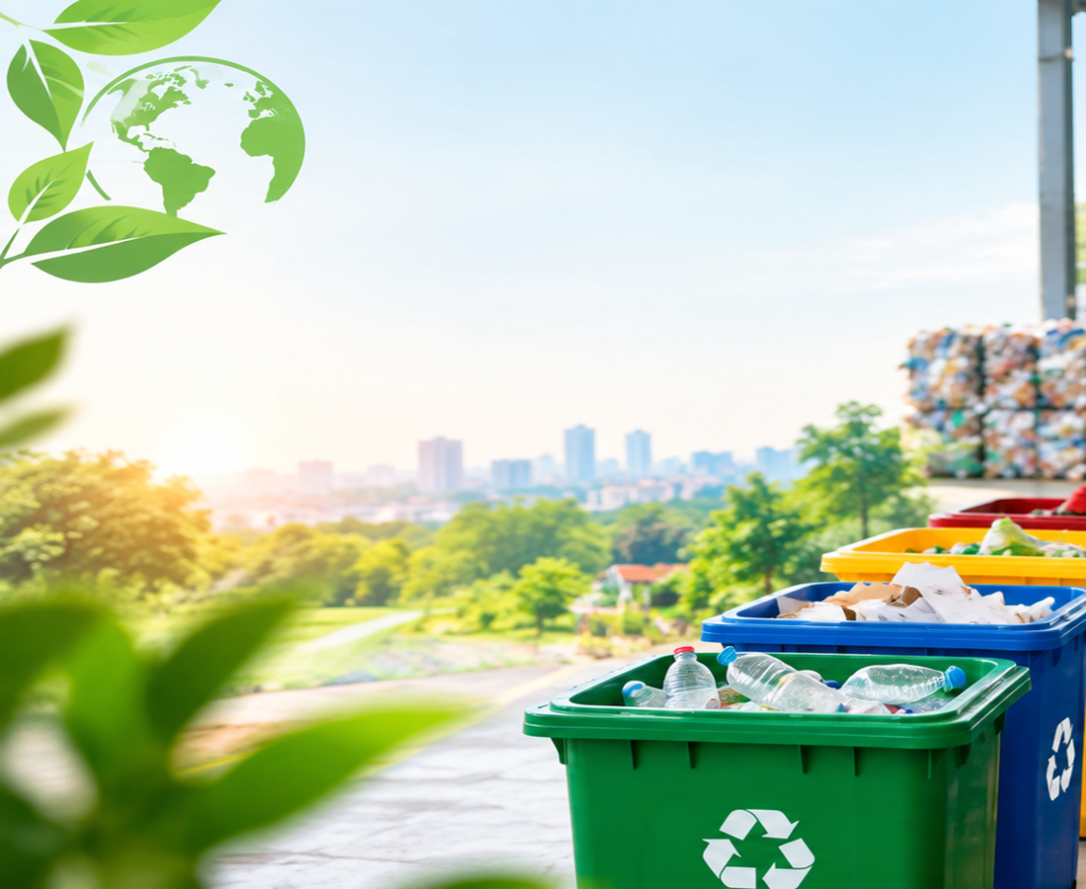
01 Introduction
A digital awareness solution for a cleaner community
What is waste management?
It is the safe collection, separation,
treatment, recycling and disposal of waste.
♻
Segregate waste correctly
🌱
Reduce pollution
🔄
Recover useful materials
💡
Build public awareness
A clean city starts with a responsible citizen.
WASTE MANAGEMENT WEBSITE
02

Slide 3
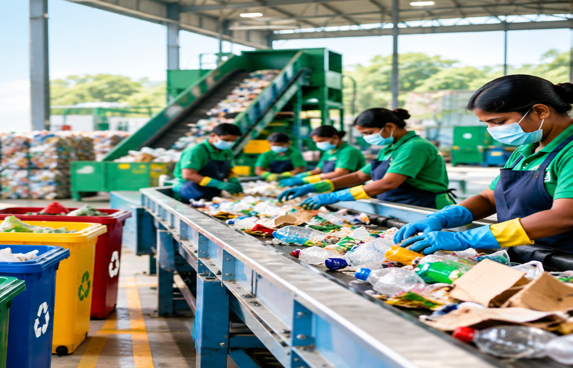
02 Problem Statement
Why a simple awareness website can help
01
Mixed waste
Wet and dry materials can get mixed.
02
Low awareness
People may not know the correct bin.
03
Pollution
Improper disposal can harm the environment.
04
Lost resources
Recyclables are wasted when mixed.
WASTE MANAGEMENT WEBSITE
03

Slide 4
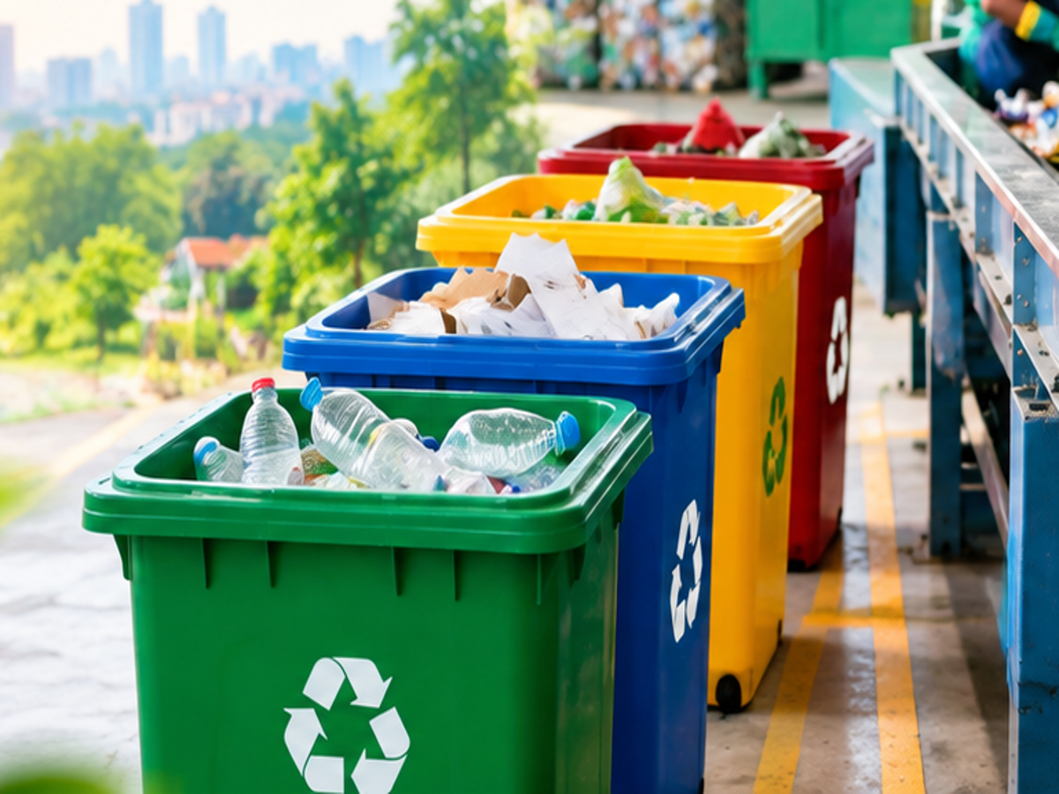
03 Proposed Solution
A clean, colorful and easy-to-use website
EcoClean | Waste Management
Home Waste Types Tips Contact
Manage waste.
Protect tomorrow.
The website explains waste types, segregation,
recycling tips and responsible disposal.
WET
DRY
E-WASTE
LEARN MORE
WASTE MANAGEMENT WEBSITE
04

Slide 5
04 Key Features
Simple modules with clear visual guidance
01
Home Page
02
Waste Types
03
Segregation Guide
Project introduction and awareness.
Wet, dry, recyclable and e-waste.
Know which waste goes where.
04
Recycling Tips
05
Awareness
06
Contact / Help
Reduce, reuse and recycle ideas.
Encourages cleaner daily habits.
Feedback and user questions.
WASTE MANAGEMENT WEBSITE
05

Slide 6
05 Waste Segregation
The right waste in the right stream
SORT SMART
WET
Food • Leaves
DRY
Paper • Plastic
E-WASTE
Phones • Batteries
SPECIAL
Handle safely
Segregation makes collection and recycling easier.
WASTE MANAGEMENT WEBSITE
06

Slide 7
06 Project Workflow
How the website connects awareness to action
1
→
2
→
3
→
4
→
5
VISIT
LEARN
SORT
COLLECT
RECYCLE
User opens website
Checks waste type
Uses correct bin
Waste is collected
Useful material recovered
Awareness → Segregation → Collection → Recovery
WASTE MANAGEMENT WEBSITE
07

Slide 8
07 Technology Used
Simple tools keep the project easy to build and maintain
HTML5
CSS3
Structure & content
Colors, layout & responsive design
JavaScript
API
Buttons and interaction
Optional live data integration
Goal: simple • attractive • responsive • easy to understand
WASTE MANAGEMENT WEBSITE
08

Slide 9
08 Benefits & Conclusion
A small digital solution can encourage
big environmental habits.
✓
Cleaner surroundings
✓
Better segregation
✓
More recycling
✓
Less landfill waste
✓
Public awareness
REDUCE • REUSE • RECYCLE
THANK YOU
https://tranquil-lollipop-f1f8e9.netlify.app

